Slide 1
Growth Mindset (Grit)

Slide 2
Q: What is an important ingredient in the learning process?
A: FAILURE

Slide 3
FAILURE IS NOT SOMETHING TO FEAR
“Failure is not a step backward; it’s an excellent stepping stone to success. We never learn to move out of our comfort zone if we don’t overcome our fear of failure.
The most progressive companies deliberately seek employees with track records reflecting both failure and success. That’s because someone who survives failure has gained irreplaceable knowledge and the unstoppable perseverance born from overcoming hardship.”
~William Arruda, Forbes.com~

Slide 4
So what does failure have to do with growth mindset or grit?
A: Our mindsets have a significant impact on how we view failure and success

Slide 5
Mindset Self-Assessment
Record the number (0-3) for each question which best describes you
Total and record your score when you have completed each of the 10 questions
Using the SCORE chart, record your mindset

Slide 6
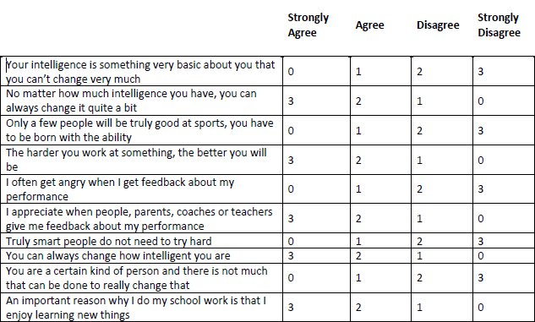

Mindset Self-Assessment

Slide 7
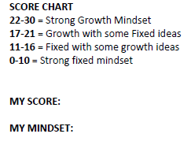
Mindset Self-Assessment

Slide 8
What encompasses a Fixed Mindset?
A fixed mindset assumes
that our character, intelligence, and creative ability are static givens.
That we can’t change these traits in any meaningful way.
That success is the affirmation of that inherent intelligence.
That striving for success and avoiding failure at all costs become ways of maintaining the sense of being smart or skilled.

Slide 9
Nurturing a Growth Mindset
A growth mindset
thrives on challenge and sees failure “as a heartening springboard for growth and for stretching our existing abilities.”
They feel a person’s true potential is unknown.
They feel it’s impossible to foresee what can be accomplished with years of passion, toil, and training.

Slide 10
Growth Mindset
A growth mindset is based on the belief that your basic qualities are things you can cultivate through your efforts.
Although people may differ in every which way (in their initial talents and aptitudes, interests, or temperaments), everyone can change and grow through application and experience.

Slide 11
Nurturing a Growth Mindset
In one world, failure is about having a setback. Getting a bad grade. Losing a tournament. Getting fired. Getting rejected. To a person with a Fixed Mindset …It means you’re not smart or talented.
However, in the other world, real failure is about not growing and not reaching for the things you value. It means you’re not fulfilling your potential.

Slide 12
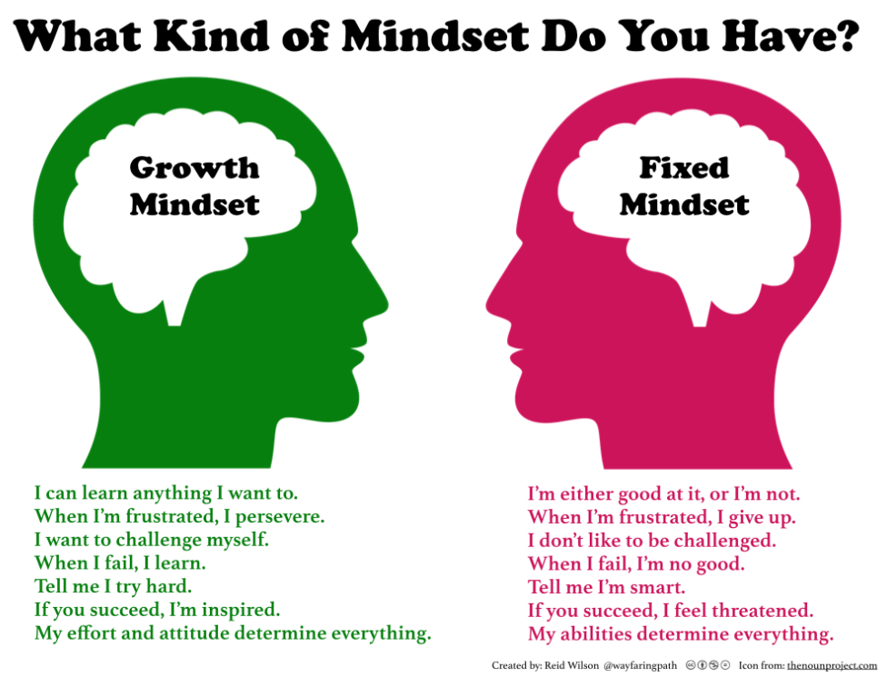

Slide 13
Growth Mindset
Underlying principles of growth mindset:
Belief: in change, capacity to grow, and build skills
Focus: on process, journey, getting better
Please play https://www.youtube.com/watch?v=ElVUqv0v1EE

Slide 14
GRIT
Grit is the tendency to sustain interest in and effort toward very long-term goals. (Sticking with things and not giving up)
It has been found that grit—a combination of passion and perseverance for a singularly important goal—is the hallmark of high achievers in every domain.
There is also scientific evidence that grit can grow.

Slide 15


Slide 16
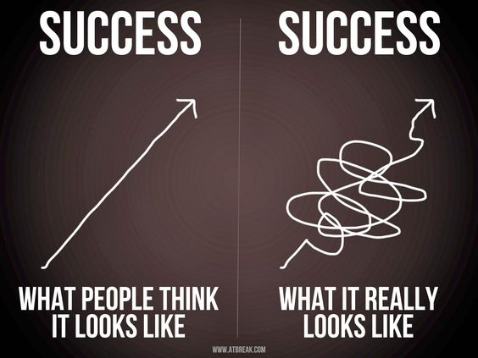

Slide 17
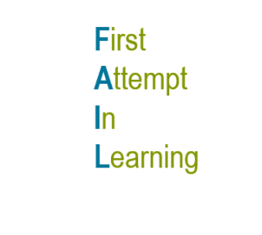

Slide 18
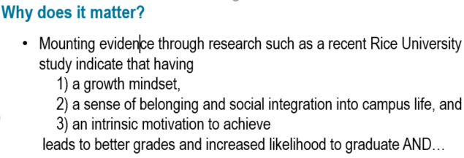
A Growth Mindset…

Slide 19
How can I adapt my growth mindset?
A: Try something new, make mistakes, reflect
Try a different approach
Making mistakes is part of the process
Focus on what will I learn/what did I learn (rather than success or failure)

Slide 20
Guess What?
You are capable of much more than you think
I believe in everyone here…but the ultimate goal is for you to also believe in yourself
Failure is ok…but you need to stand up after you fall / fail
We will all support each other as we take risks and attempt new learning
You will be challenged – embrace the challenges and the successes that come once you overcome the challenges
You can go beyond your self-perceived limits… your instructors may push you because we want you to succeed and we want you to be successful in our industry

Slide 21
Last Video
Please play https://www.youtube.com/watch?v=0Q6a_rD85X0

